Slide 1
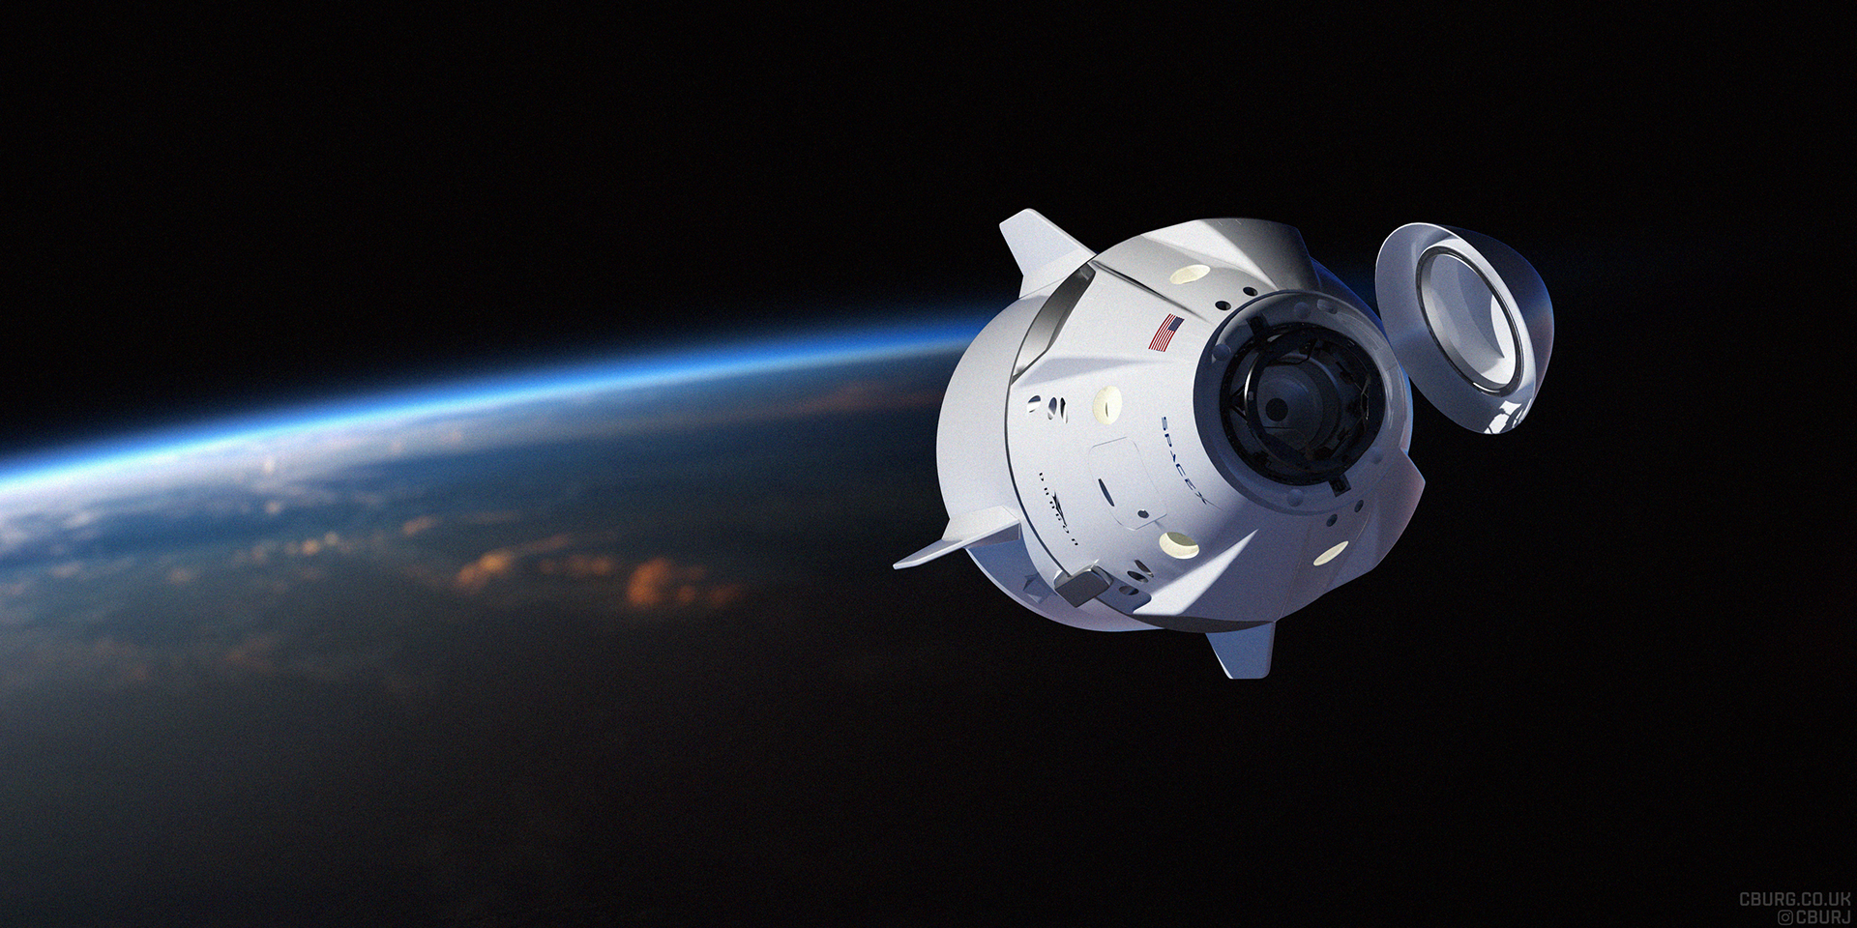

Winning Space Race with Data Science
<Name>
<Date>
Joaquin Koifman
23/03/2023

Slide 2
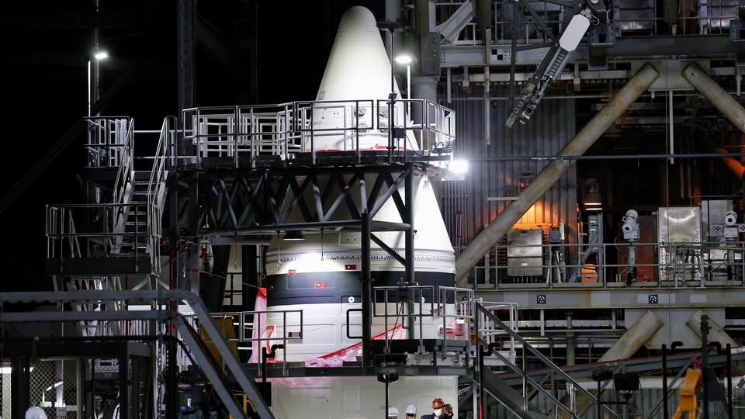

Outline
Executive Summary
Introduction
Methodology
Results
Conclusion

Slide 3
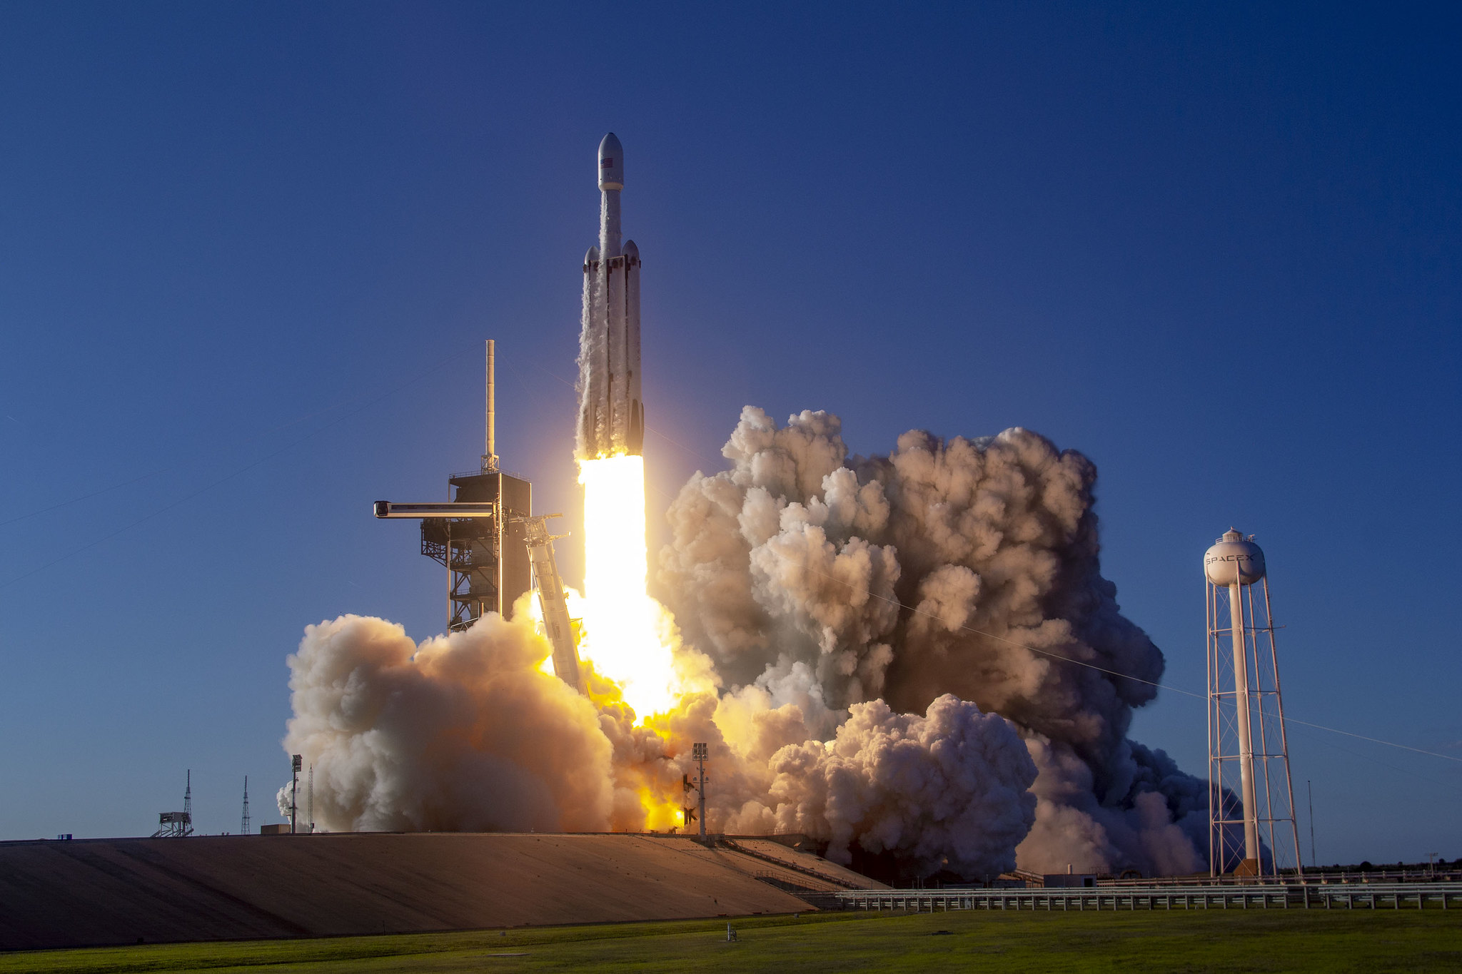
Executive Summary
Summary of Methodologies
The goal of this investigation is to identify the factors for the successful landing of the Falcon 9, a Space X rocket. To carry out this investigation, different methodologies were used, such as:
Collect data using several techniques.
Wrangle data to create success/fail outcome variable.
Explore data with data visualization techniques.
Analyze the data with SQL.
Explore launch site success rates and proximity to geographical markers.
Visualize the launch sites with the most success and successful payload ranges.
Build Models to predict landing outcomes.
Search
How payload mass, launch site, number of flights, and orbits affect first-stage landing success
Rate of successful landings over time
Best predictive model for successful landing (binary classification)

Slide 4
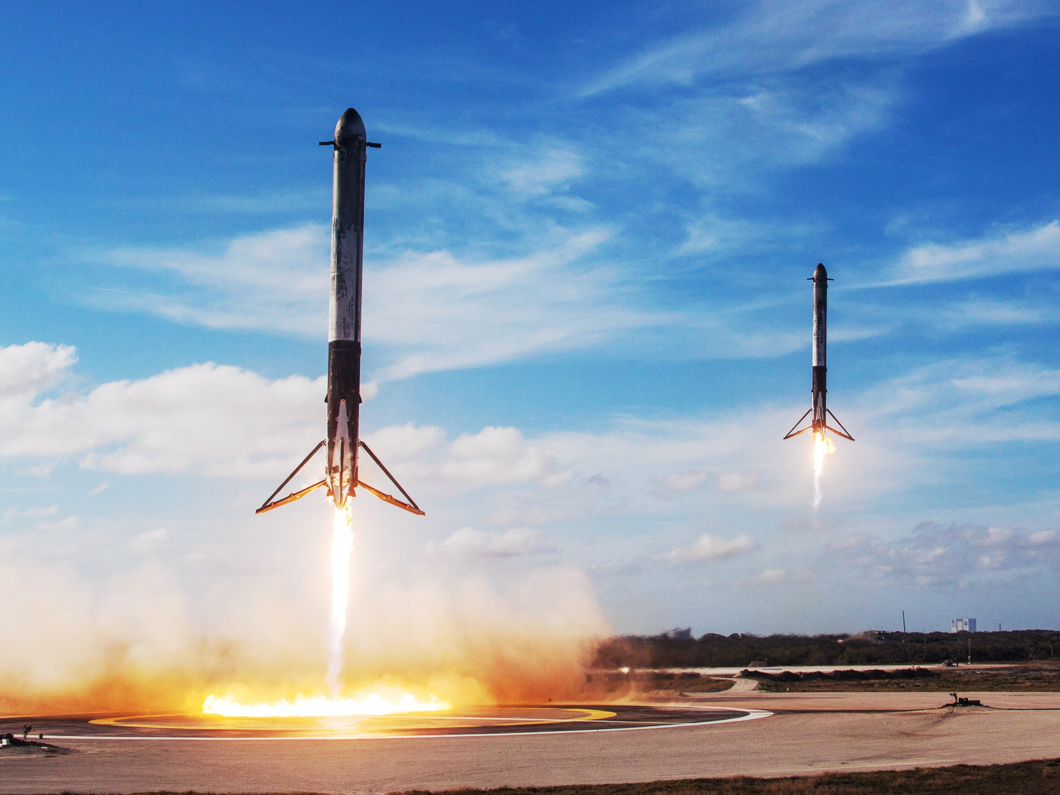
Introduction
Context
The aim of this capstone if to predict if the Falcon 9 first stage will land successfully. SpaceX advertises Falcon 9 rocket launches on its website, with a cost of 62 million dollars; other providers cost upward of 165 million dollars each, much of the savings is because SpaceX can reuse the first stage. Therefore if we can determine if the first stage will land, we can determine the cost of a launch. This information can be used if an alternate company wants to bid against SpaceX for a rocket launch.
Therefore, what we're trying to determine is, if the first stage of Falcon 9 will land successfully or not.

Slide 5
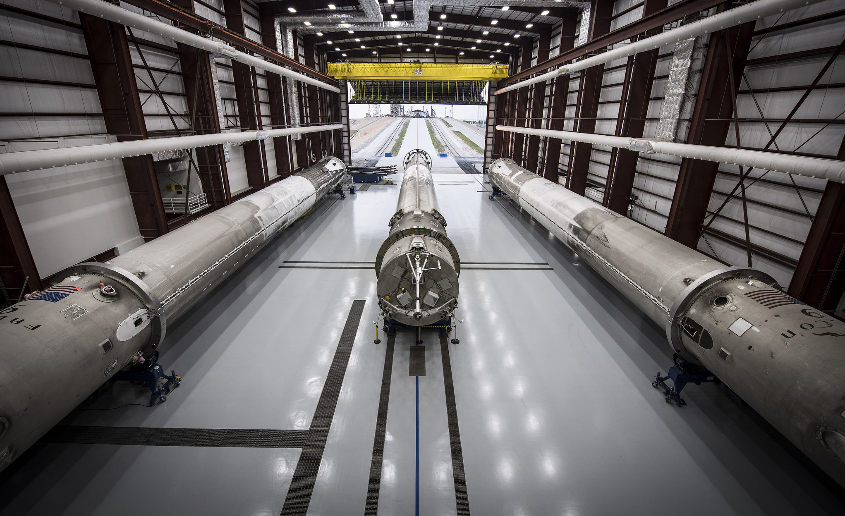
Section 1
Methodology

Slide 6
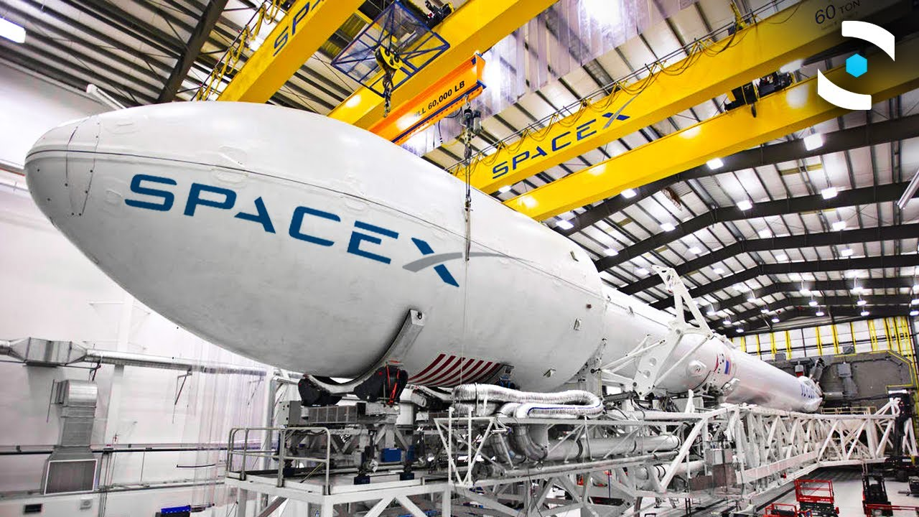
Methodology
Step by step:
Collecting data was performed by using SpaceX REST API and web scraping techniques
Wrangling data by filtering the data and handling missing values, in order to prepare the data for analysis and modeling
Exploring data analysis using visualization and SQL
Visualizing analytics using Folium and Plotly Dash
Predicting and analyzing data by using classification models as to predict landing outcomes using classification models. Testing each one of them to find the best one.

Slide 7
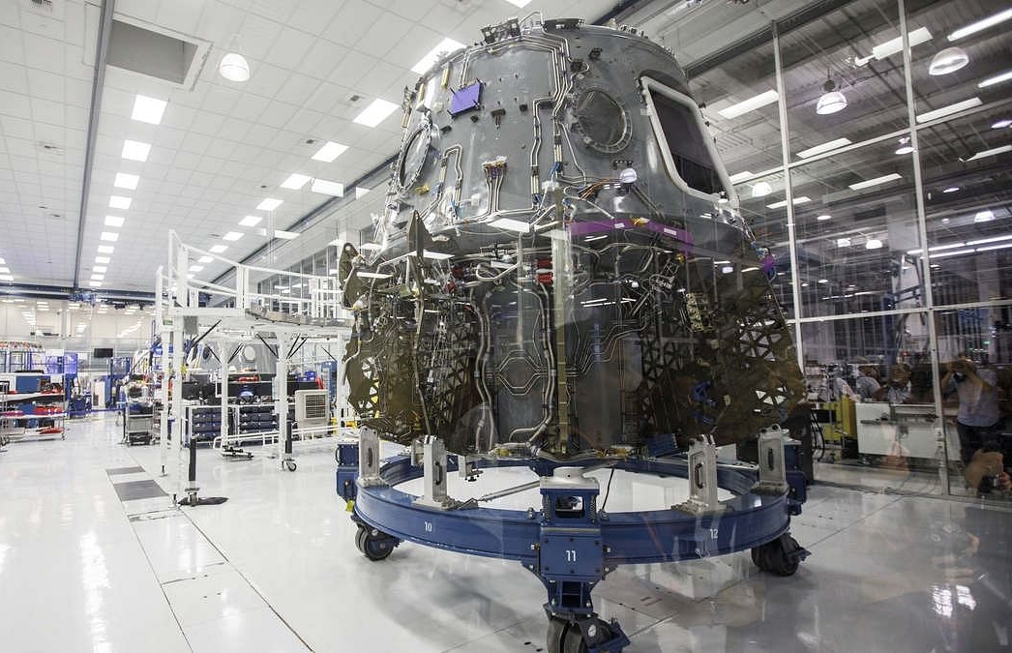
Data Collection (API)
Steps:
Request the rocket launch data from SpaceX API
Normalize the response by using JSON to convert it into a dataframe
Get information about the launches using the API
Create a new dataframe
Filter the dataframe to only include Falcon 9 launches
Dealing with Missing Values
Export data to csv file

Slide 8
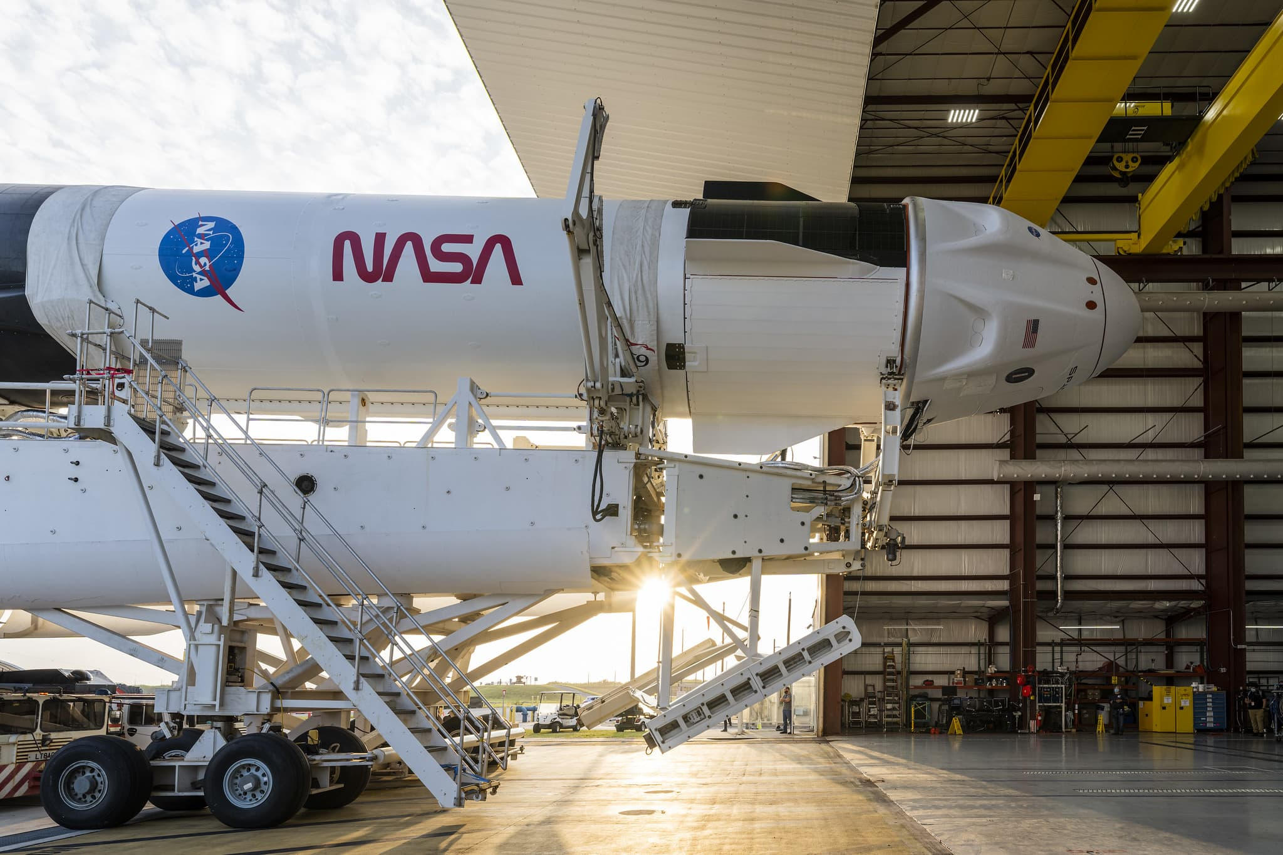
Data Collection
Web Scraping
Steps:
Request the Falcon 9 launch data from Wikipedia
Extract column/variable names from HTML table header
Create a dataframe by parsing the launch HTML tables
Export data to csv file

Slide 9
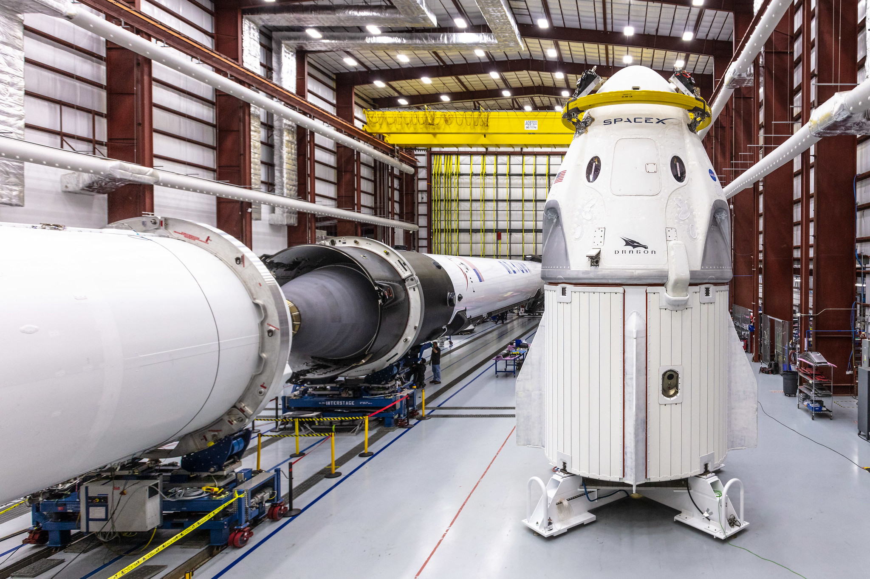
Data Wrangling
Steps:
Calculate the number of launches on each site
Calculate the number and occurrence of each orbit
Calculate the number and occurence of mission outcome per orbit type
Create a landing outcome label from Outcome column
Export to csv

Slide 10
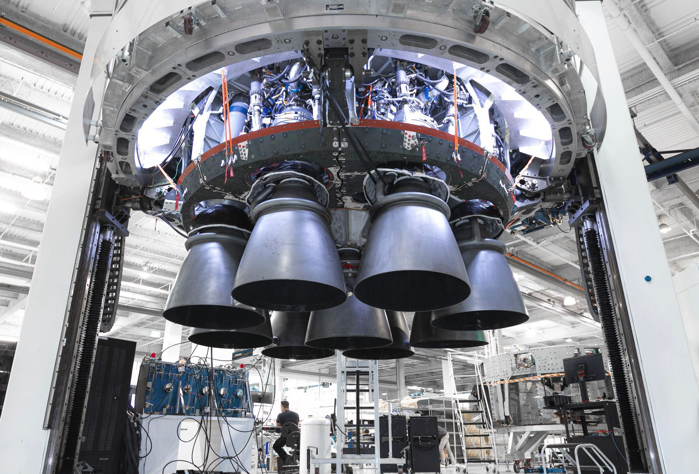
EDA with Data Visualization
Charts:
Scatter plots: are used to represent the relationship between two variables. Some of the variables that were analyzed were:
Flight Number vs. Launch Site
Payload vs. Launch Site
Flight Number vs. Orbit Type
Payload vs. Orbit Type.
Bar charts: are used to show comparisons among discrete categories. They show the relationships among the categories and a measured value. In this case bar charts were used to analyze the plotted bar chart try to find which orbits have high success rate
Line chart: are useful for showing data trends over time. For example, here it was used to show success rate over a certain number of years.

Slide 11
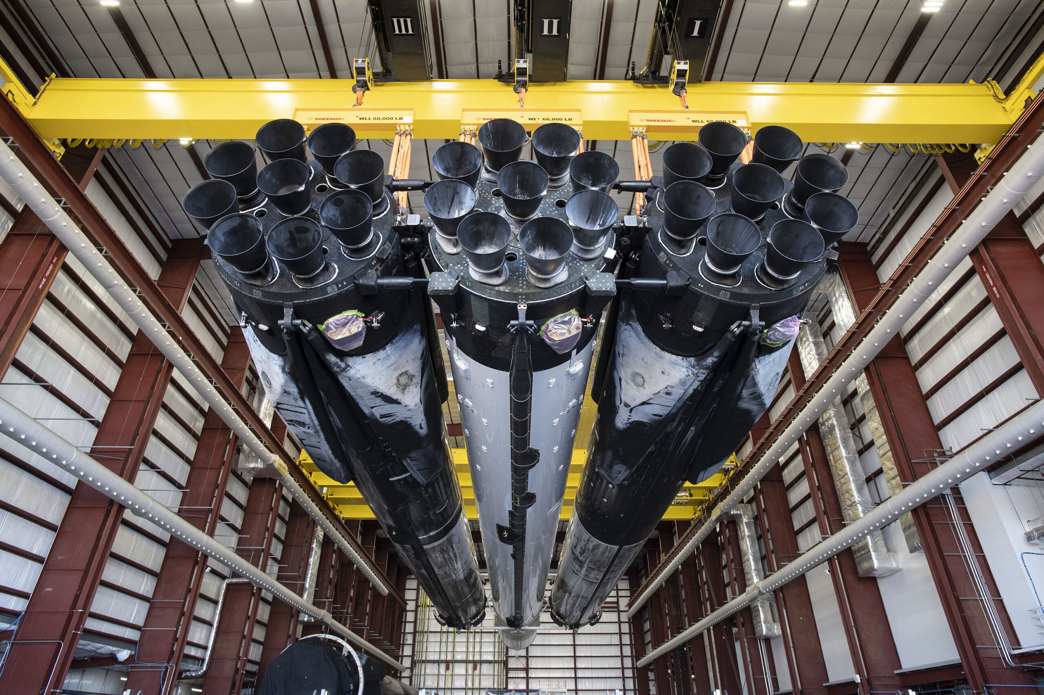
EDA with SQL
List of the SQL queries and lists that were used on the dataset:
Names of unique launch sites
5 records where launch site begins with ‘CCA’
Total payload mass carried by boosters launched by NASA (CRS)
Average payload mass carried by booster version F9 v1.1.
Date of first successful landing on ground pad
Names of boosters which had success landing on drone ship and have payload mass greater than 4,000 but less than 6,000
Total number of successful and failed missions
Names of booster versions which have carried the max payload
Failed landing outcomes on drone ship, their booster version and launch site for the months in the year 2015
Count of landing outcomes between 2010-06-04 and 2017-03-20 (desc)

Slide 12
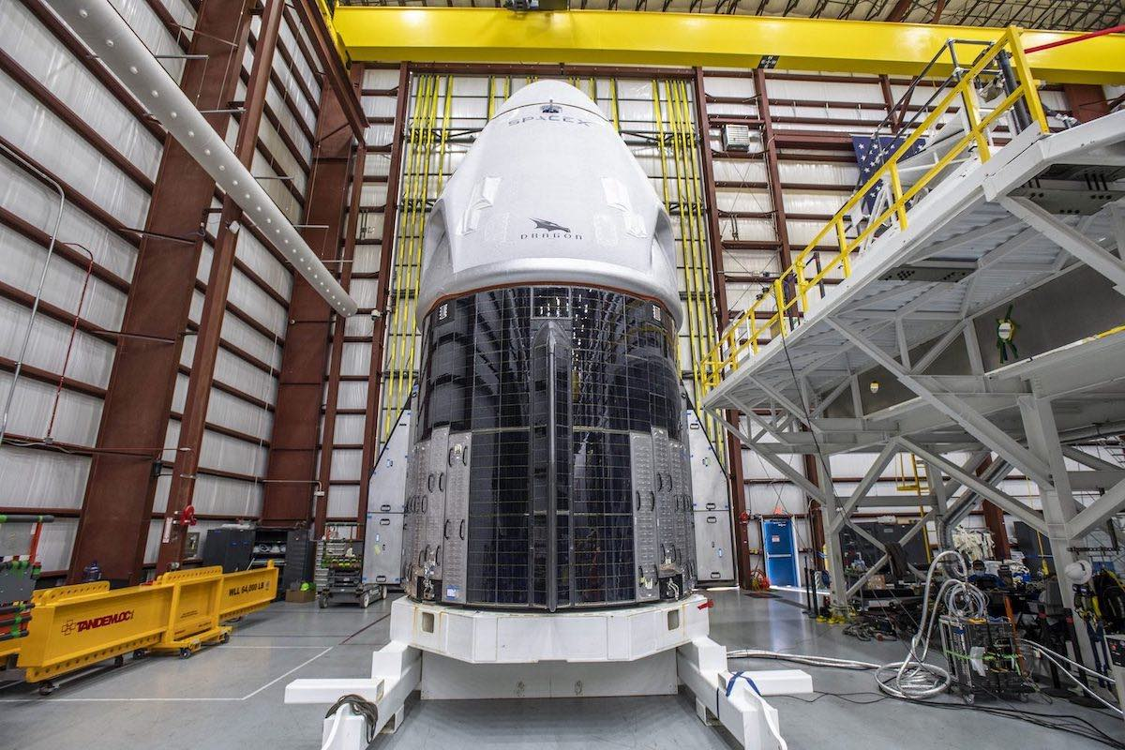
Interactive Map with Folium
Marking launch sites
by using location on the map using site's latitude and longitude coordinates, a highlighted yellow circle area with a text label on a specific coordinate of the launch was added.
Succeeded and failed launches
by adding color-labeled markers in marker clusters for each site, it is easily to identify successful (green) and unsuccessful (red) launches at each launch site to show which launch sites have high success rates
Calculate the distances between a launch site to its proximities
by adding colored lines to show distance between launch sites and its proximity to the nearest coastline, railway, highway, and city using latitudes an longitudes to locate them

Slide 13
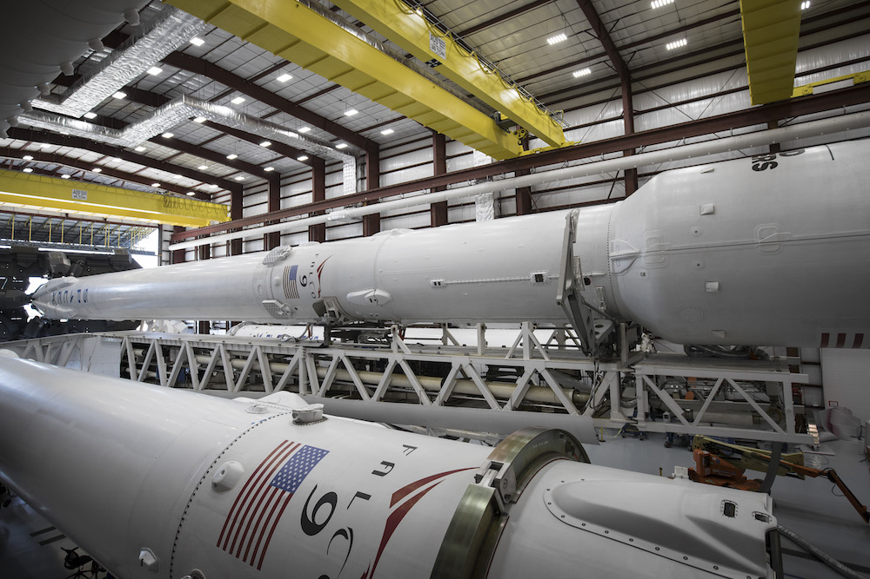
Dashboard with Plotly Dash
The dashboard contains:
Dropdown List with Launch Sites: allows the user to select all launch sites or a certain launch site.
Pie Chart Showing Successful Launches: allows the user to see all successful and unsuccessful launches as a percent of the success rate of each site.
Slider of Payload Mass Range: allows the user to select payload mass range
Scatter Chart Showing Payload Mass vs. Success Rate by Booster Version: allows user to visualize how different variables affect the landing outcomes.

Slide 14
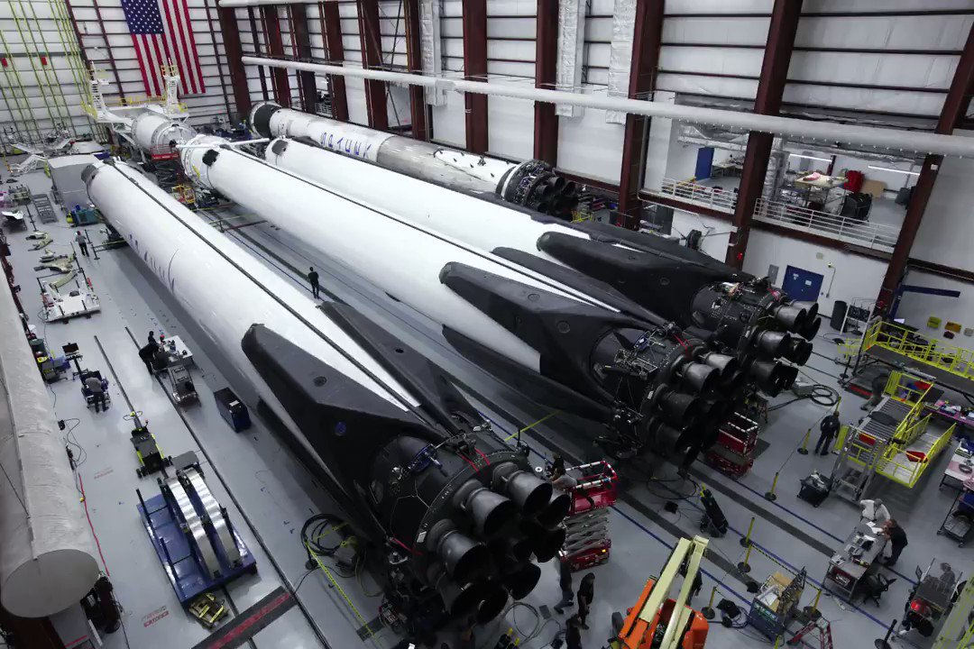
Predictive Analysis (Classification)
Create a NumPy array from the column Class in data
Standardize the data. Fit and transform the data.
Split the data using train_test_split
Create a logistic regression object then create a GridSearchCV object. Fit the object to find the best parameters.
Apply GridSearchCV on different algorithms: logistic regression, support vector machine (SVC), decision tree and K-Nearest Neighbor.
Calculate the accuracy on the test data for each model
Identify the best model using the test data to evaluate models based on their accuracy scores and confusion matrix

Slide 15
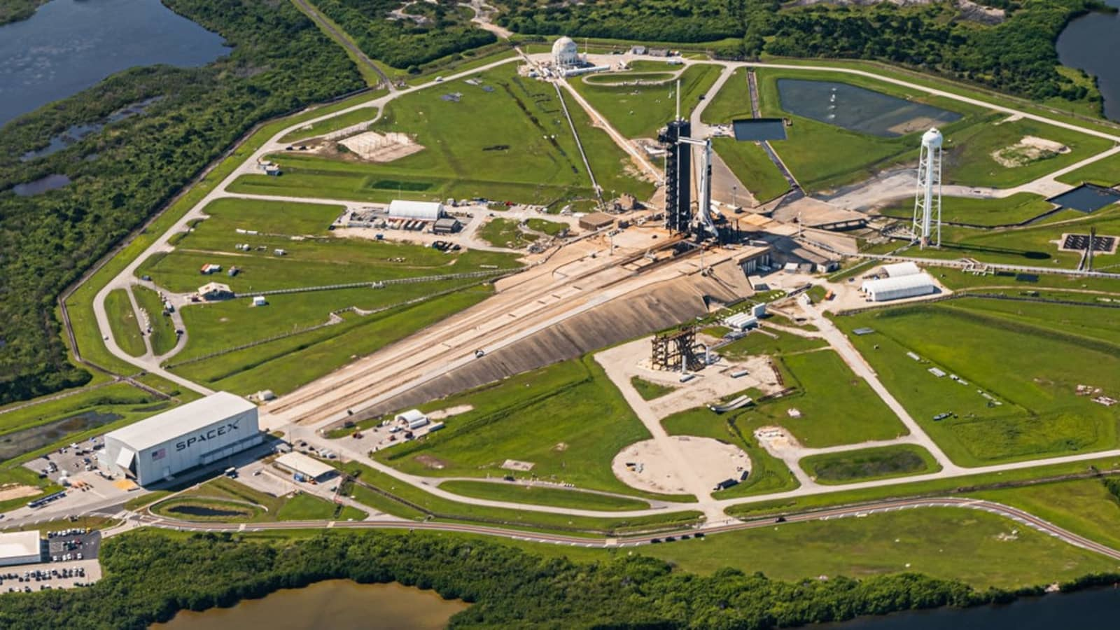
Results

Slide 16
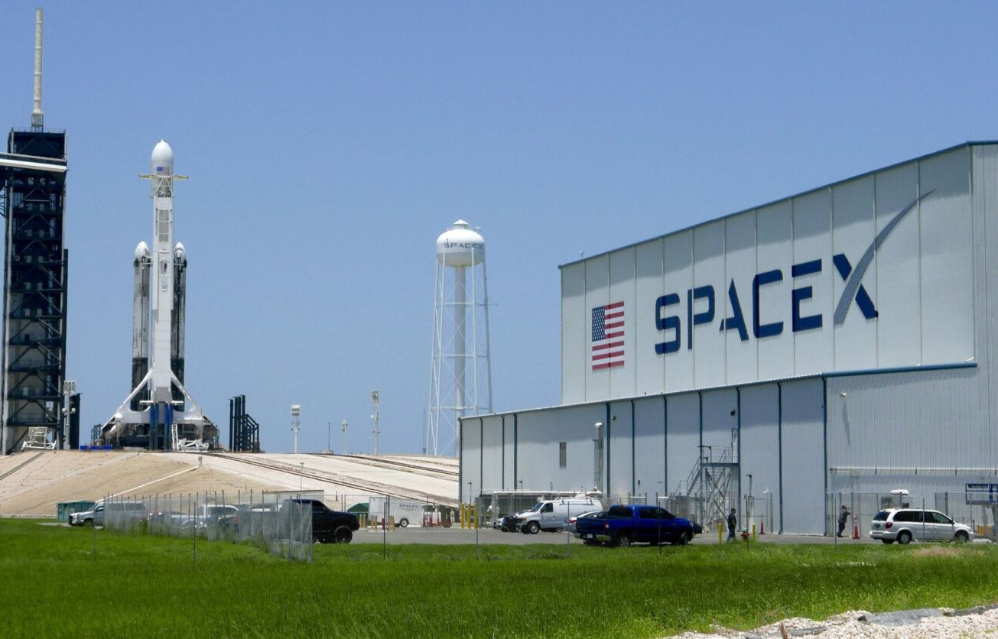
Results
Exploratory data analysis results:
Launch success has improved over time.
KSC LC-39A has the highest success rate among landing sites
Orbits ES-L1, GEO, HEO and SSO have a 100% success rate
Interactive analytics demo in screenshots:
Most launch sites are between the parallel 35N and 28N (or near the equator), and all of them are close to the coast
Every launch Facility is far enough away from anything a failed launch can damage (city, highway, railway).
Predictive analysis results
The Decision Tree model is the best predictive model for the dataset, with an accuracy of the 83.33% on the data test.

Slide 17
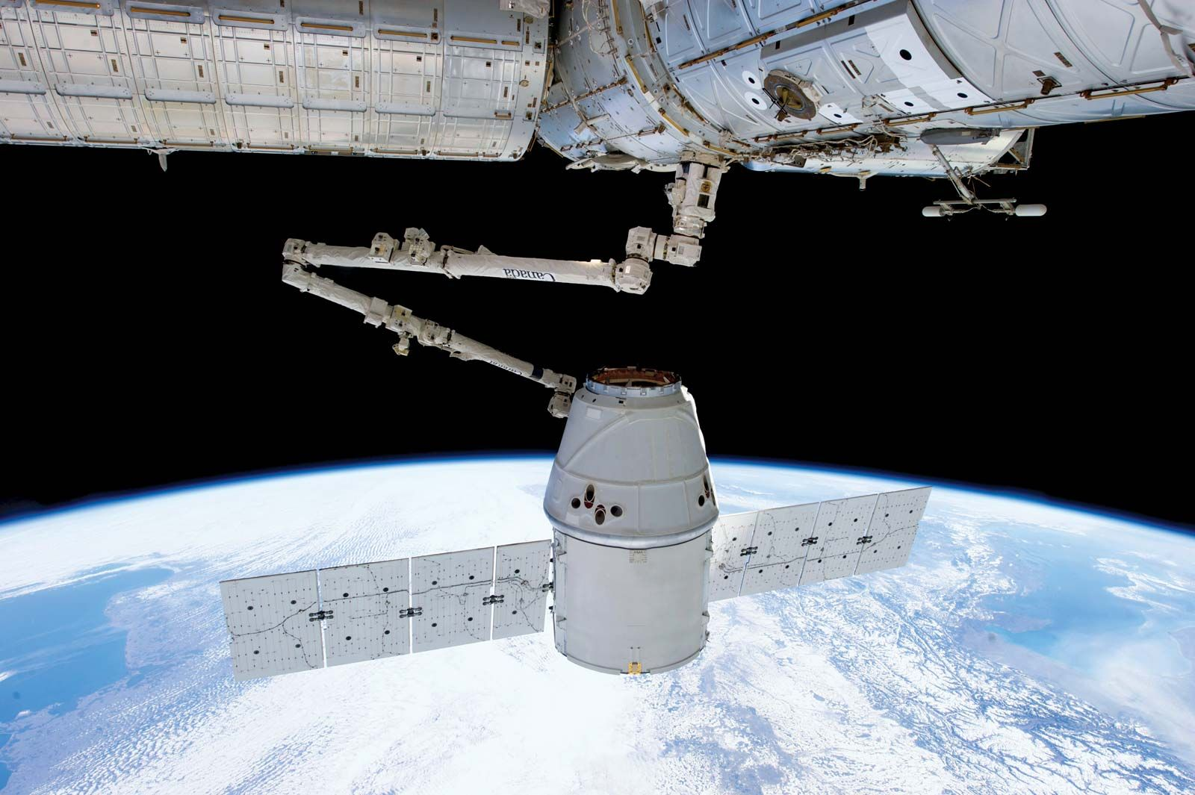
Section 2
Insights drawn
From EDA

Slide 18
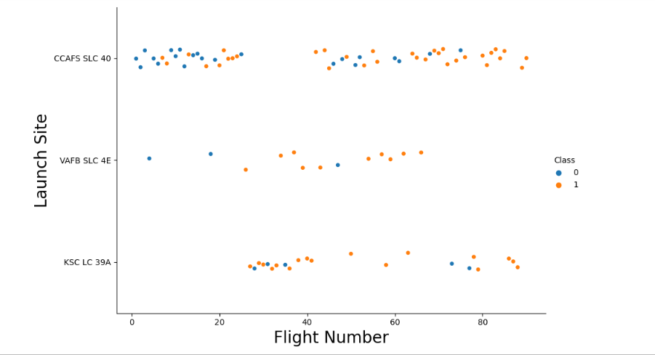
Flight Number vs. Launch Site
Exploratory Data Analysis:
Most of the firsts flights tend to had an unsuccessful ending witch are represented by blue dots. After a while, flights were succeeding their landings, these are represented with orange dots
Around half of launches were from CCAFS SLC 40, and VAFB SLC 4E and KSC LC 39A have higher success rates

Slide 19
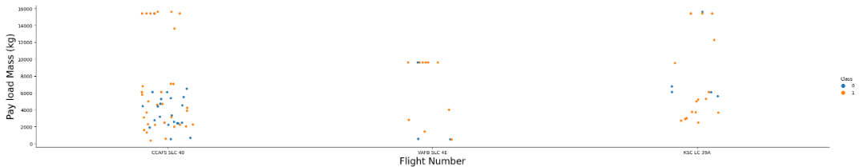
Payload vs. Launch Site
Exploratory Data Analysis:
In general, the success rate is higher, if the payload mass is higher too.
VAFB SKC 4E has only 2 unsuccessful launches and also it has not launches anything greater than 10000 kg
KSC LC 39A has a 100% success rate for launches less than 5,500 kg

Slide 20
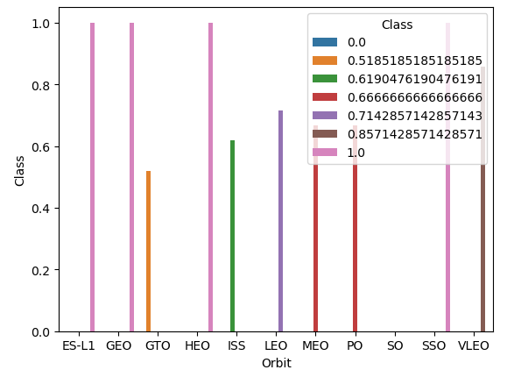
Success Rate vs. Orbit Type
Exploratory Data Analysis:
100% Success Rate: ES-L1, GEO, HEO and SSO
50%-80% Success Rate: GTO, ISS, LEO, MEO, PO
0% Success Rate: SO

Slide 21
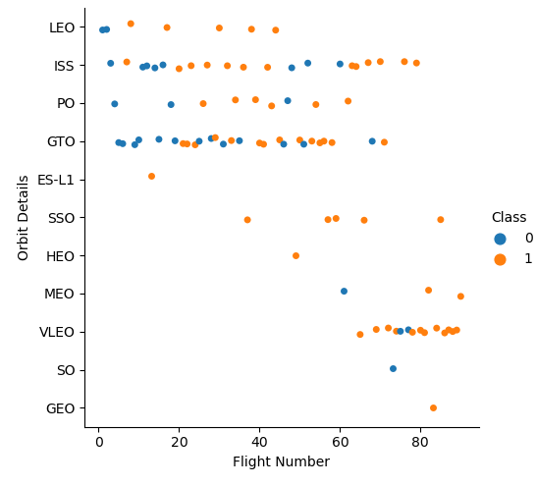
Flight Number vs. Orbit Type
Exploratory Data Analysis:
The success rate typically increases with the number of flights for each orbit (LEO)
ISS and GTO share similarities when it comes to their success rates
The SSO and GEO orbits have a 100% success rate

Slide 22
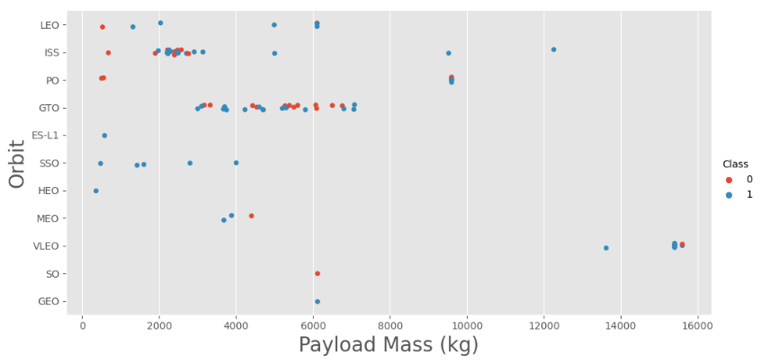
Payload vs. Orbit Type
Exploratory Data Analysis:
As the payloads get heavier, the success rate increases.
GTO orbit, alternates it success as the mass increases

Slide 23
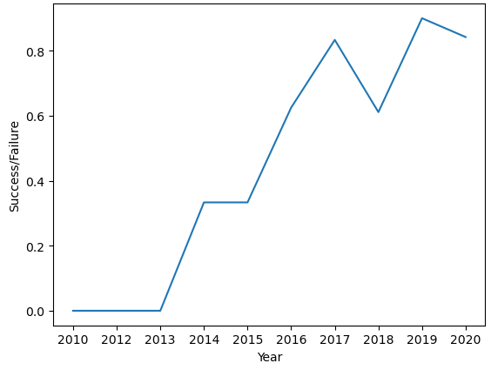
Launch Success Yearly Trend
Exploratory Data Analysis:
In general, the success rate has improved since 2013
However, the success decreased in 2018 and in 2020.

Slide 24
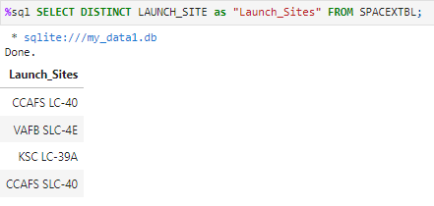
Launch Site Names
Exploratory Data Analysis:
Launch Site Names:
CCAFS LC-40
CCAFS SLC-40
KSC LC-39A
VAFB SLC-4E

Slide 25
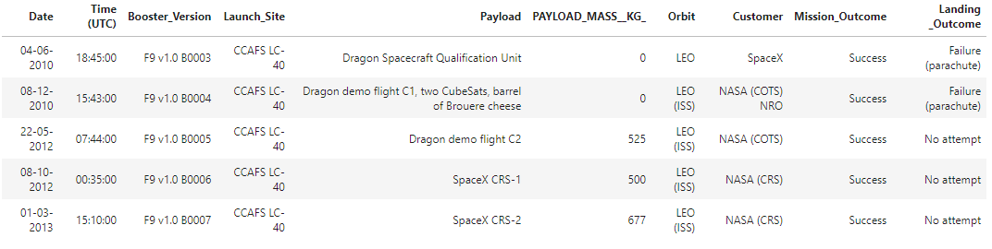
'CCA' Launch Site Names
Exploratory Data Analysis:
Records with Launch Site Starting with ‘CCA’:
Displaying 5 records below

Slide 26
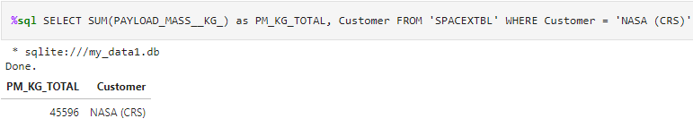
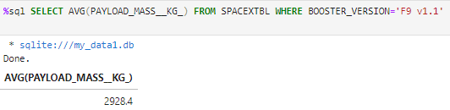
Payload Mass
Exploratory Data Analysis:
Total Payload Mass: 45,596 kg (total) carried by boosters launched by NASA (CRS)
Average Payload Mass: 2,928 kg (average) carried by booster version F9 v1.1

Slide 27
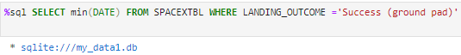

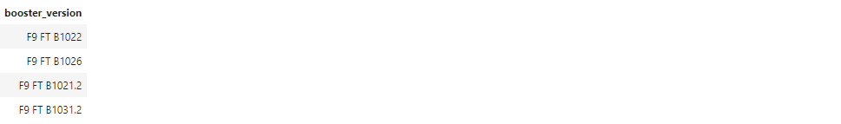
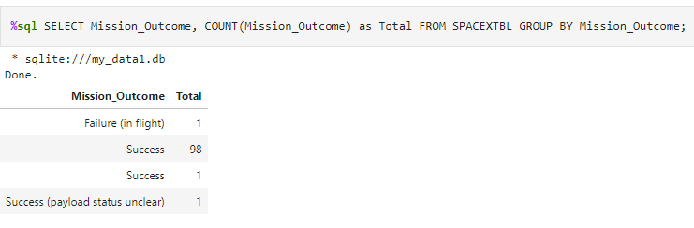
Landings and Missions
Exploratory Data Analysis:
First successful landing outcome on ground pad
Boosters which have successfully landed on drone ship and had payload mass greater than 4,000 but less than 6,000
Total Number of Successful and Failure Mission Outcomes

Slide 28
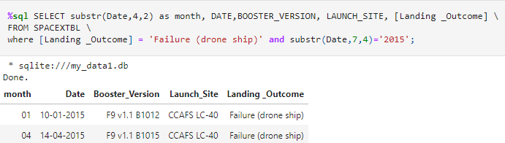
2015 Failed Launches
Exploratory Data Analysis:
The list displays the month names, failure landings outcomes in drone ship ,booster versions and launch sites for the months in year 2015.

Slide 29
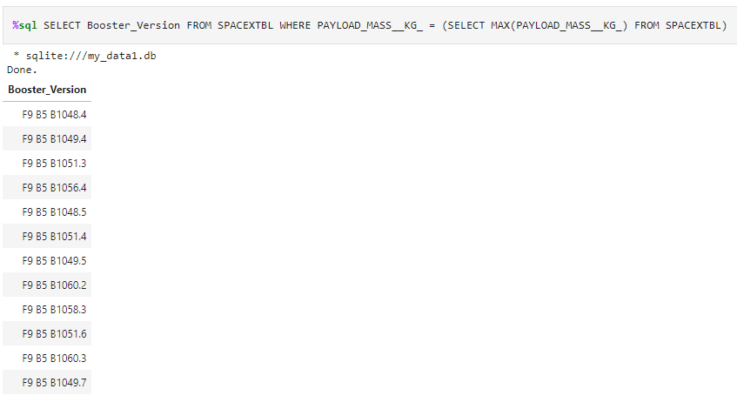
Boosters Carried Maximum Payload
Exploratory Data Analysis:
Carrying Max Payload
Booster Version:
F9 B5 B1048.4
F9 B5 B1049.4
F9 B5 B1051.3
F9 B5 B1056.4
F9 B5 B1048.5
F9 B5 B1051.4
F9 B5 B1049.5
F9 B5 B1060.2
F9 B5 B1058.3
F9 B5 B1051.6
F9 B5 B1060.3
F9 B5 B1049.7

Slide 30
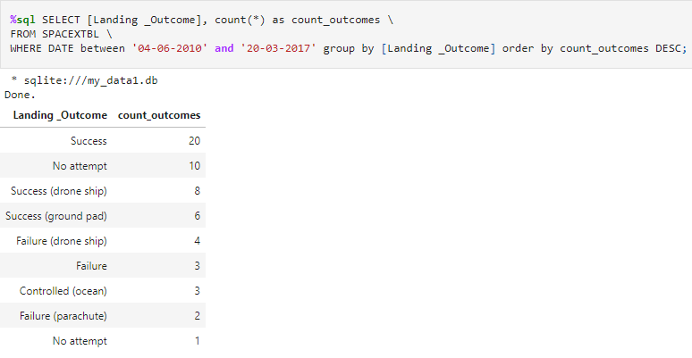
Successful Landings
Between 2010-06-04 and 2017-03-20
Exploratory Data Analysis:
The list displays the count of successful landing outcomes between the date 04-06-2010 and 20-03-2017 in descending order.

Slide 31
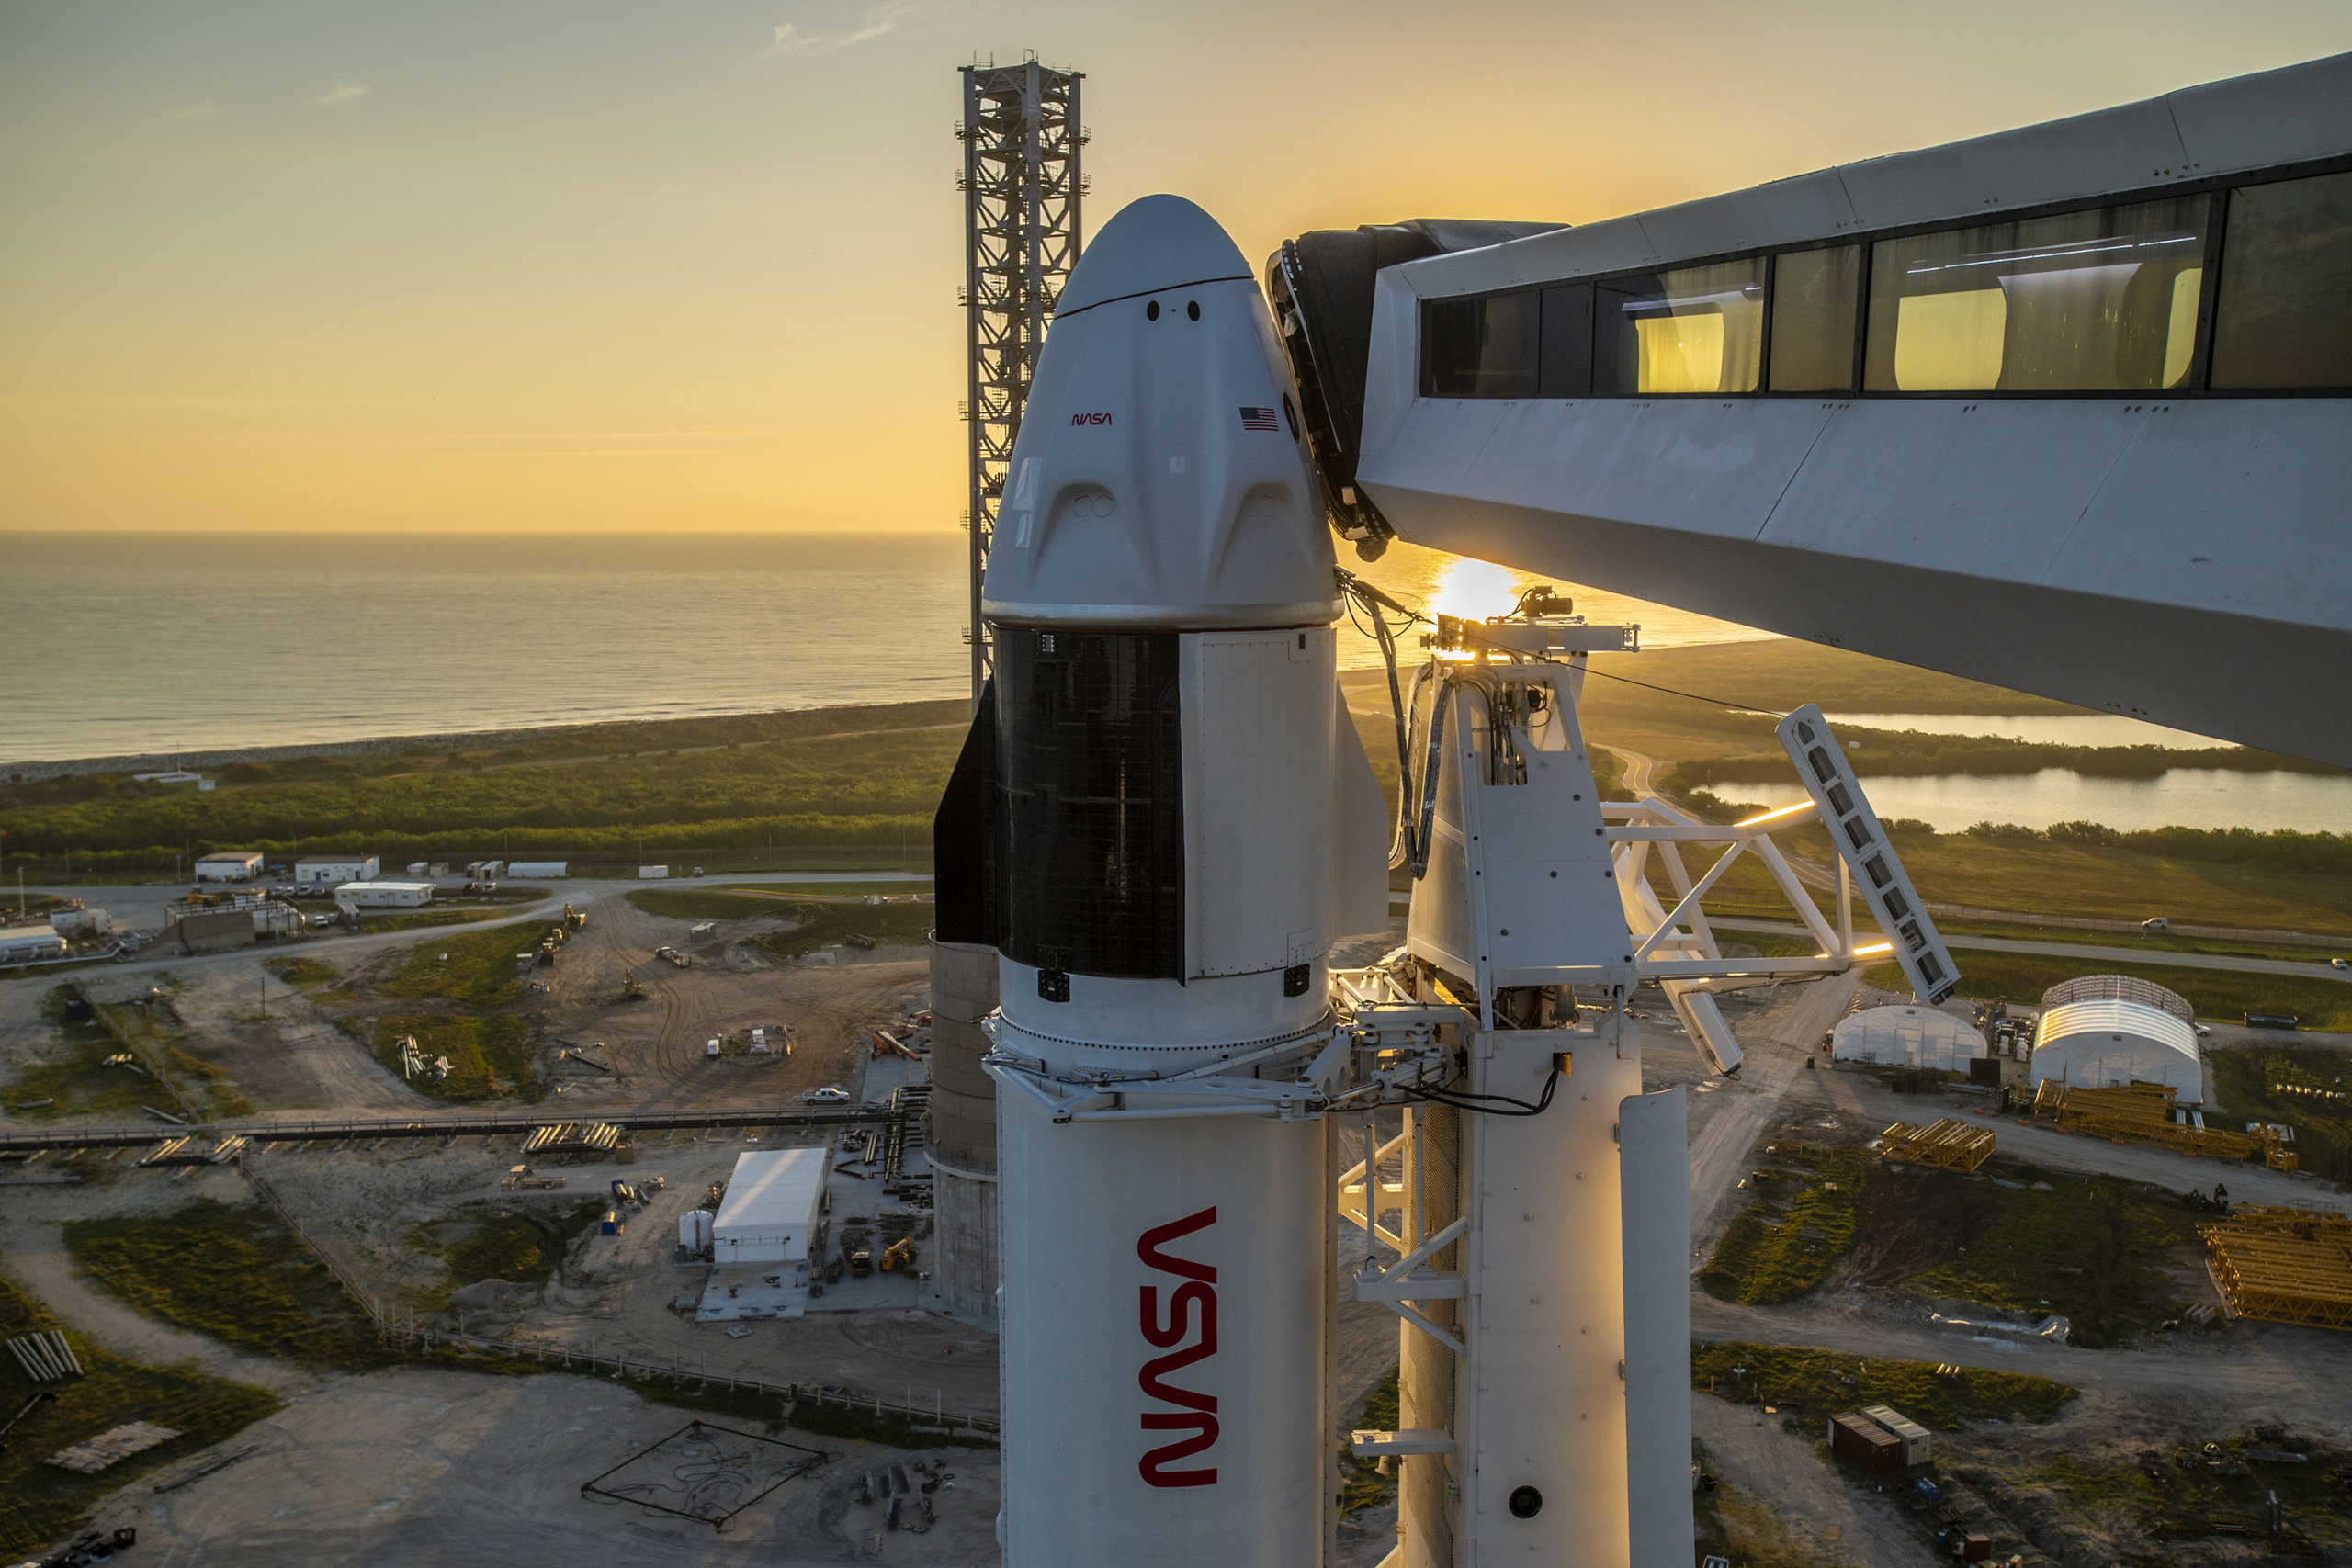
Section 3
Launch Sites
Proximities Analysis

Slide 32
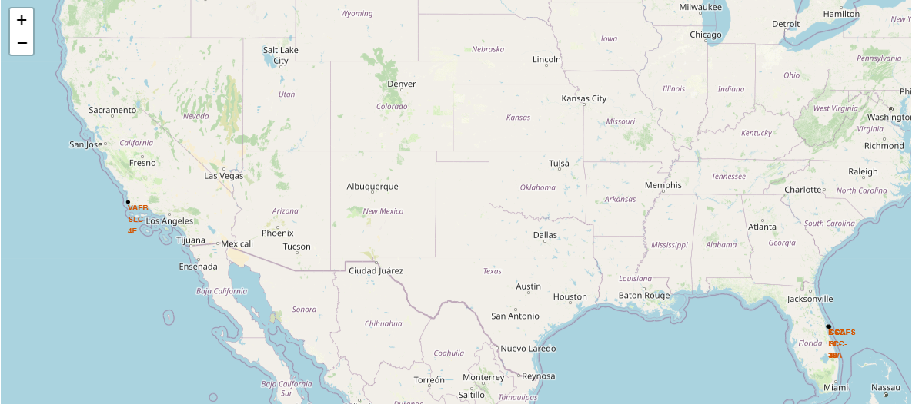
Launch Sites
Exploratory Data Analysis:
The black dots represents where the locations of all the Space X launch sites are situated in the US. These locations are strategically located “near” to de Equator because they use the equatorial orbit and the earth’s speed rotation as an additional natural boost to save time and fuel.

Slide 33

Launch Outcomes
Exploratory Data Analysis:
At each launch site there are two possible outcomes: green markers are for successful launches, and red markers are for unsuccessful launches

Slide 34
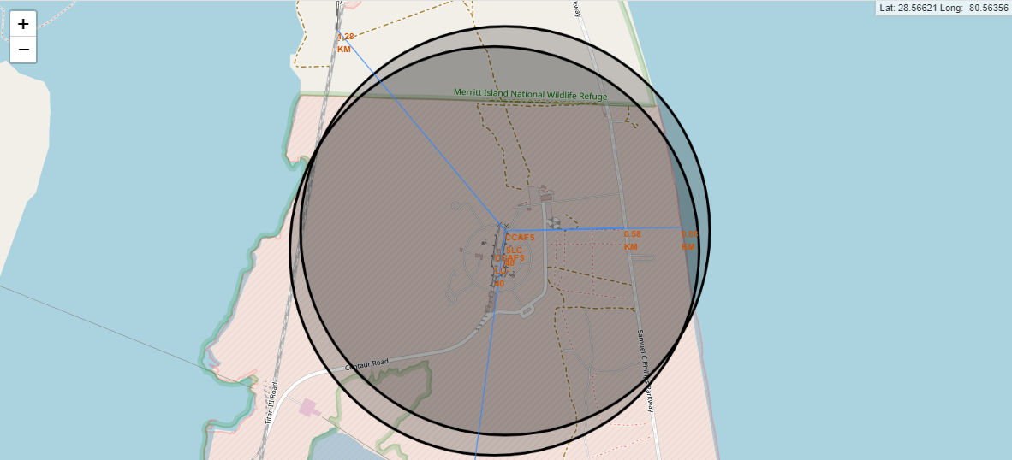
Launch Site Proximities
Exploratory Data Analysis:
The generated map shows several proximities (railways, highways, closest city and coast line, etc) to the CCAFS SLC-40 launch site with a blue line.

Slide 35
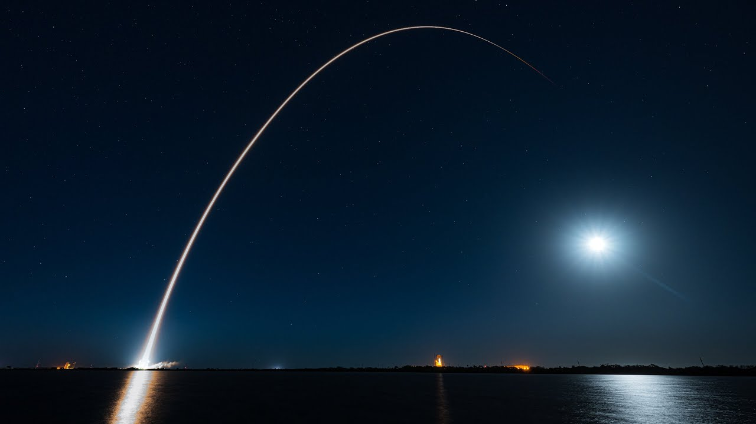
Section 4
Built a Dashboard with Ploty Dash

Slide 36
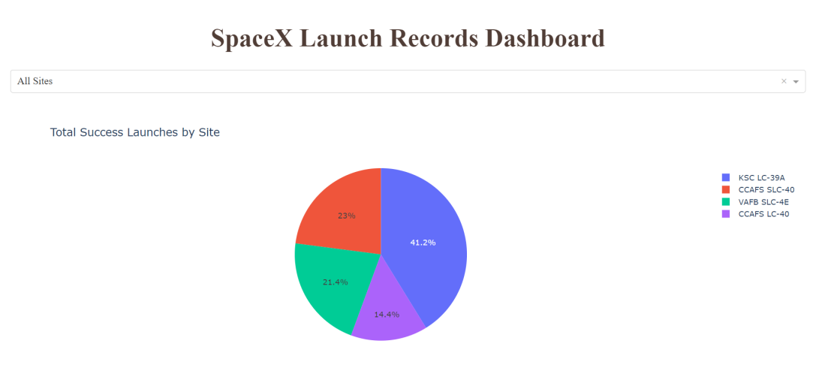
Total Success Launches by Site
Exploratory Data Analysis:
KSC LC-39A has the most successful launches amongst launch sites with a total of 10 (41.2%).

Slide 37
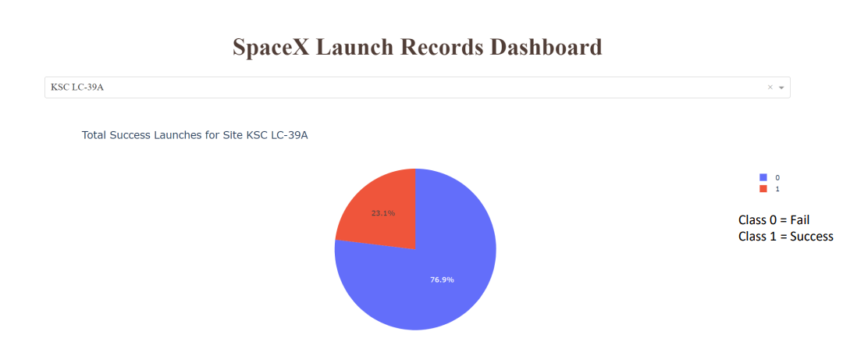
Total Success Launches For Site KSC LC-39A
Exploratory Data Analysis:
KSC LC-39A has the highest success rate amongst launch sites, with 10 successful launches and 3 failed ones (76.9%).

Slide 38
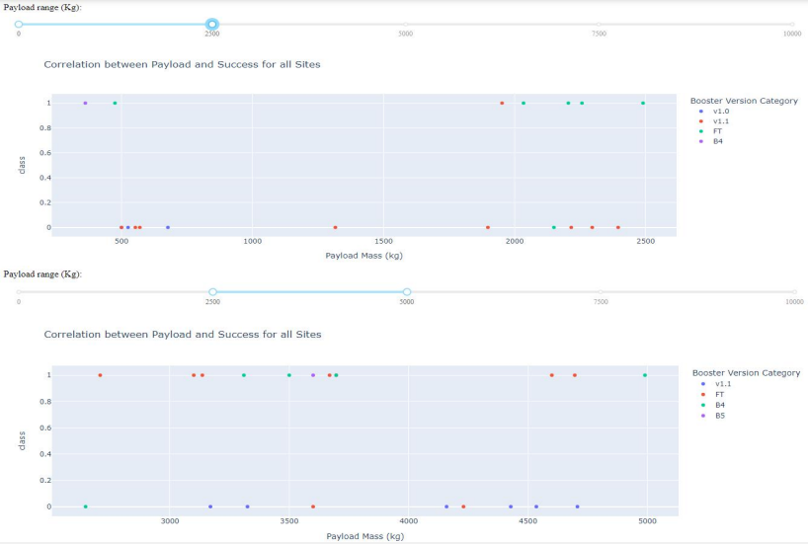
Correlation Between Payload and Success
Exploratory Data Analysis:
Payloads between 2,000 kg and 5,000 kg have the highest success rate (1 indicating successful outcome and 0 indicating an unsuccessful outcome).

Slide 39
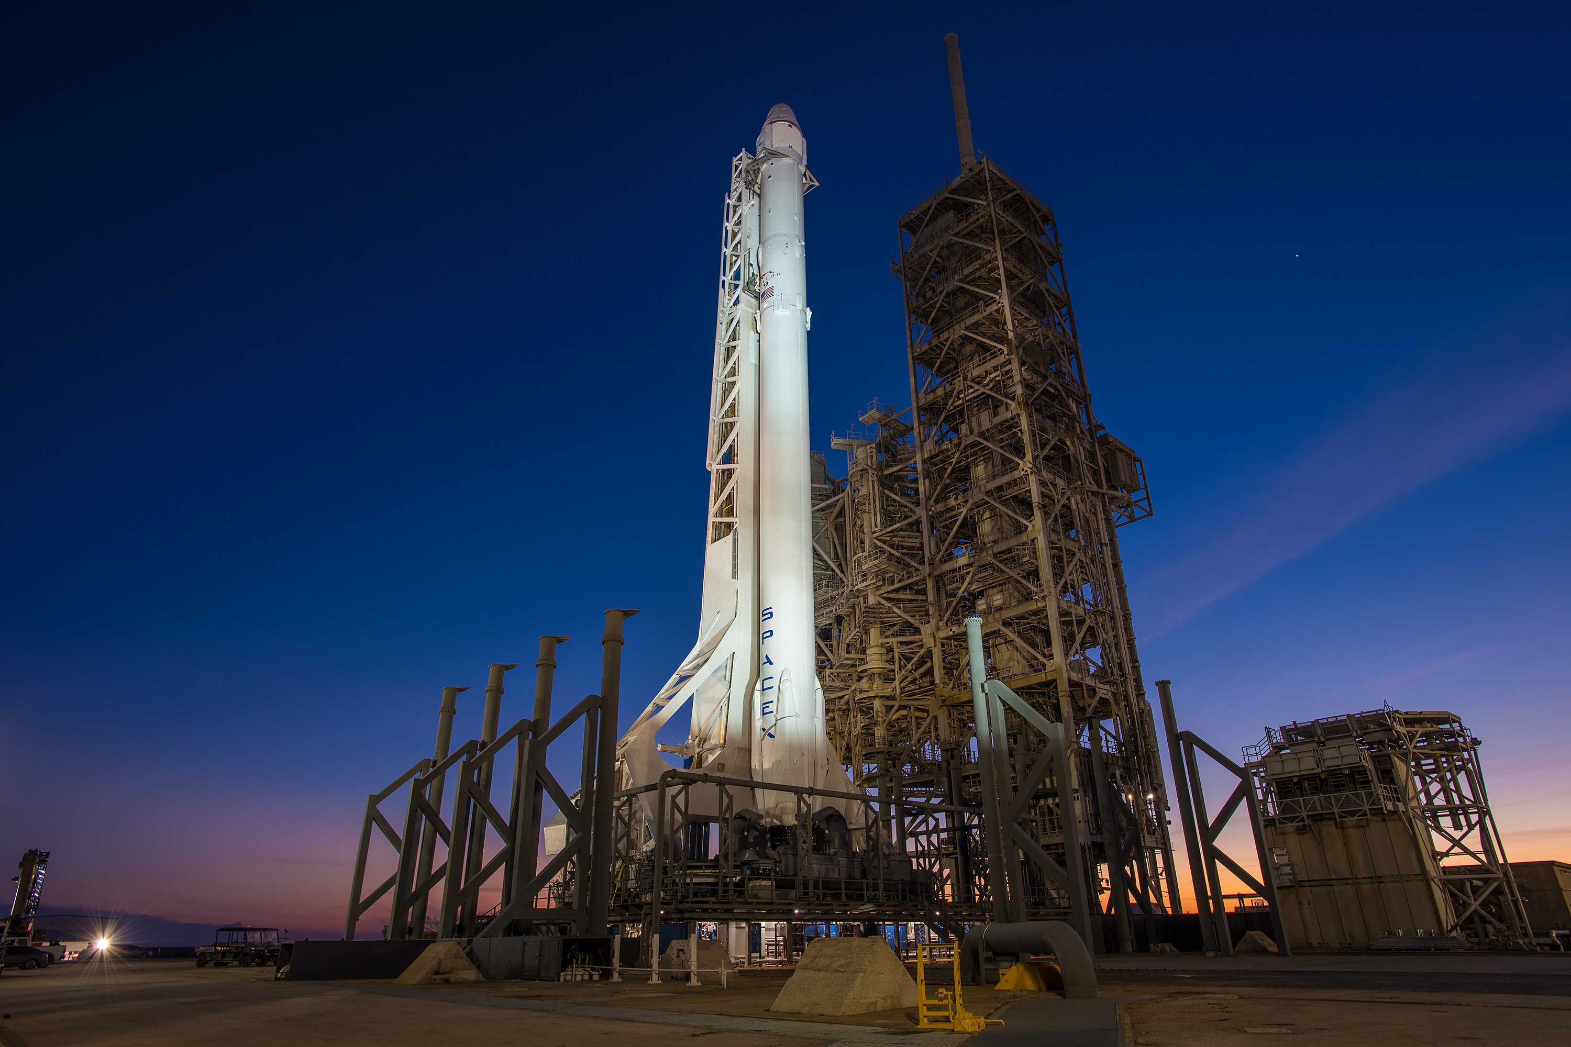
Section 5
Predictive analysis (Classification)

Slide 40
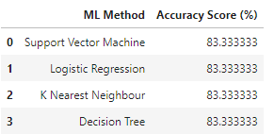
Classification Accuracy
Exploratory Data Analysis:
All four models performed at about the same level, having the same scores and accuracy. Although, the Decision Tree model slightly outperformed the rest.

Slide 41
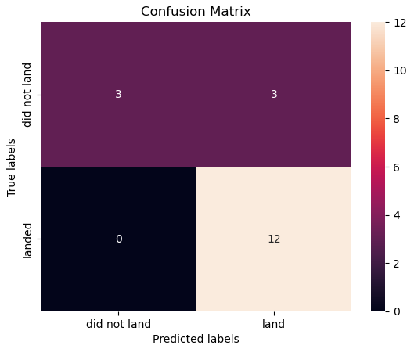
Confusion Matrix
Performance Summary
A confusion matrix summarizes the performance of a classification algorithm
All the confusion matrices were identical
The fact that there are false positives (Type 1 error) is not good
The model predicted 12 successful landings

Slide 42
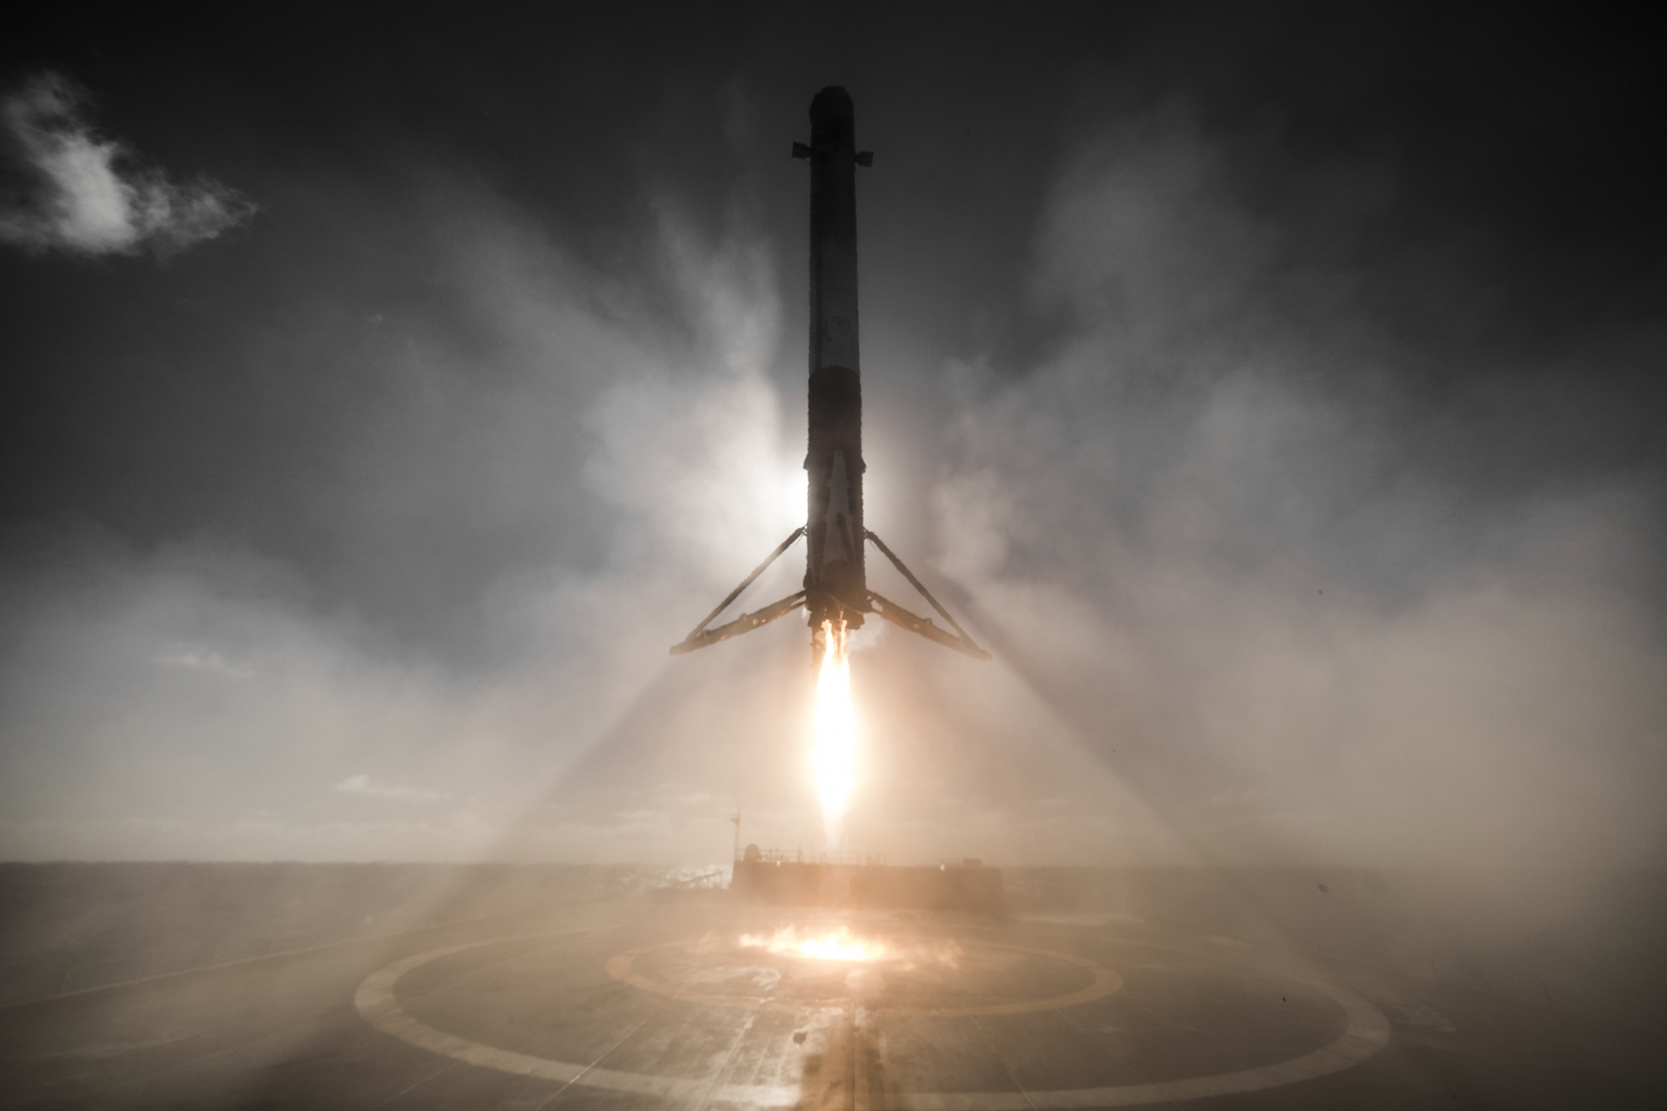
Section 6
Conclusions

Slide 43
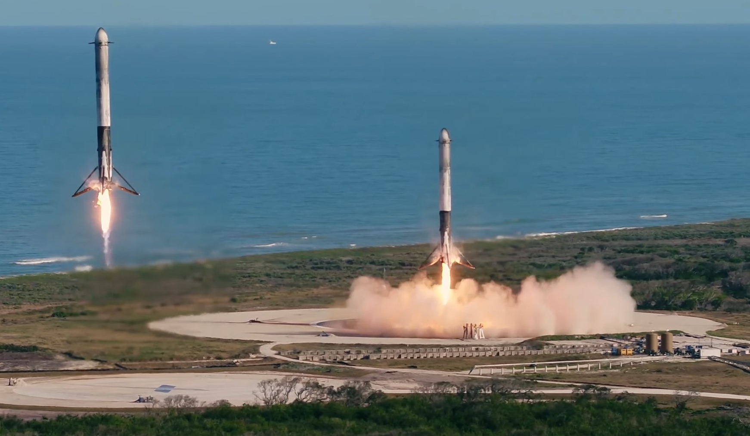
Conclusions
Launch sites: Most launches sites are strategically located “near” to de Equator because they use the equatorial orbit and the earth’s speed rotation as an additional natural boost to save time and fuel. Also, they are strategically located near highways and railways for transportation of personal and cargo, but also far away from cities for safety.
Model Performance: The models performed similarly on the test set with the decision tree model slightly outperforming.
Launch Success: Launches had been increasing over time. Having launch site KSC LC-39A with the highest success rate among launch sites.
Payload Mass: Across all launch sites, the higher the payload mass (kg), the higher the success rate
Orbits: ES-L1, GEO, HEO, and SSO have a 100% success rate.

Slide 44
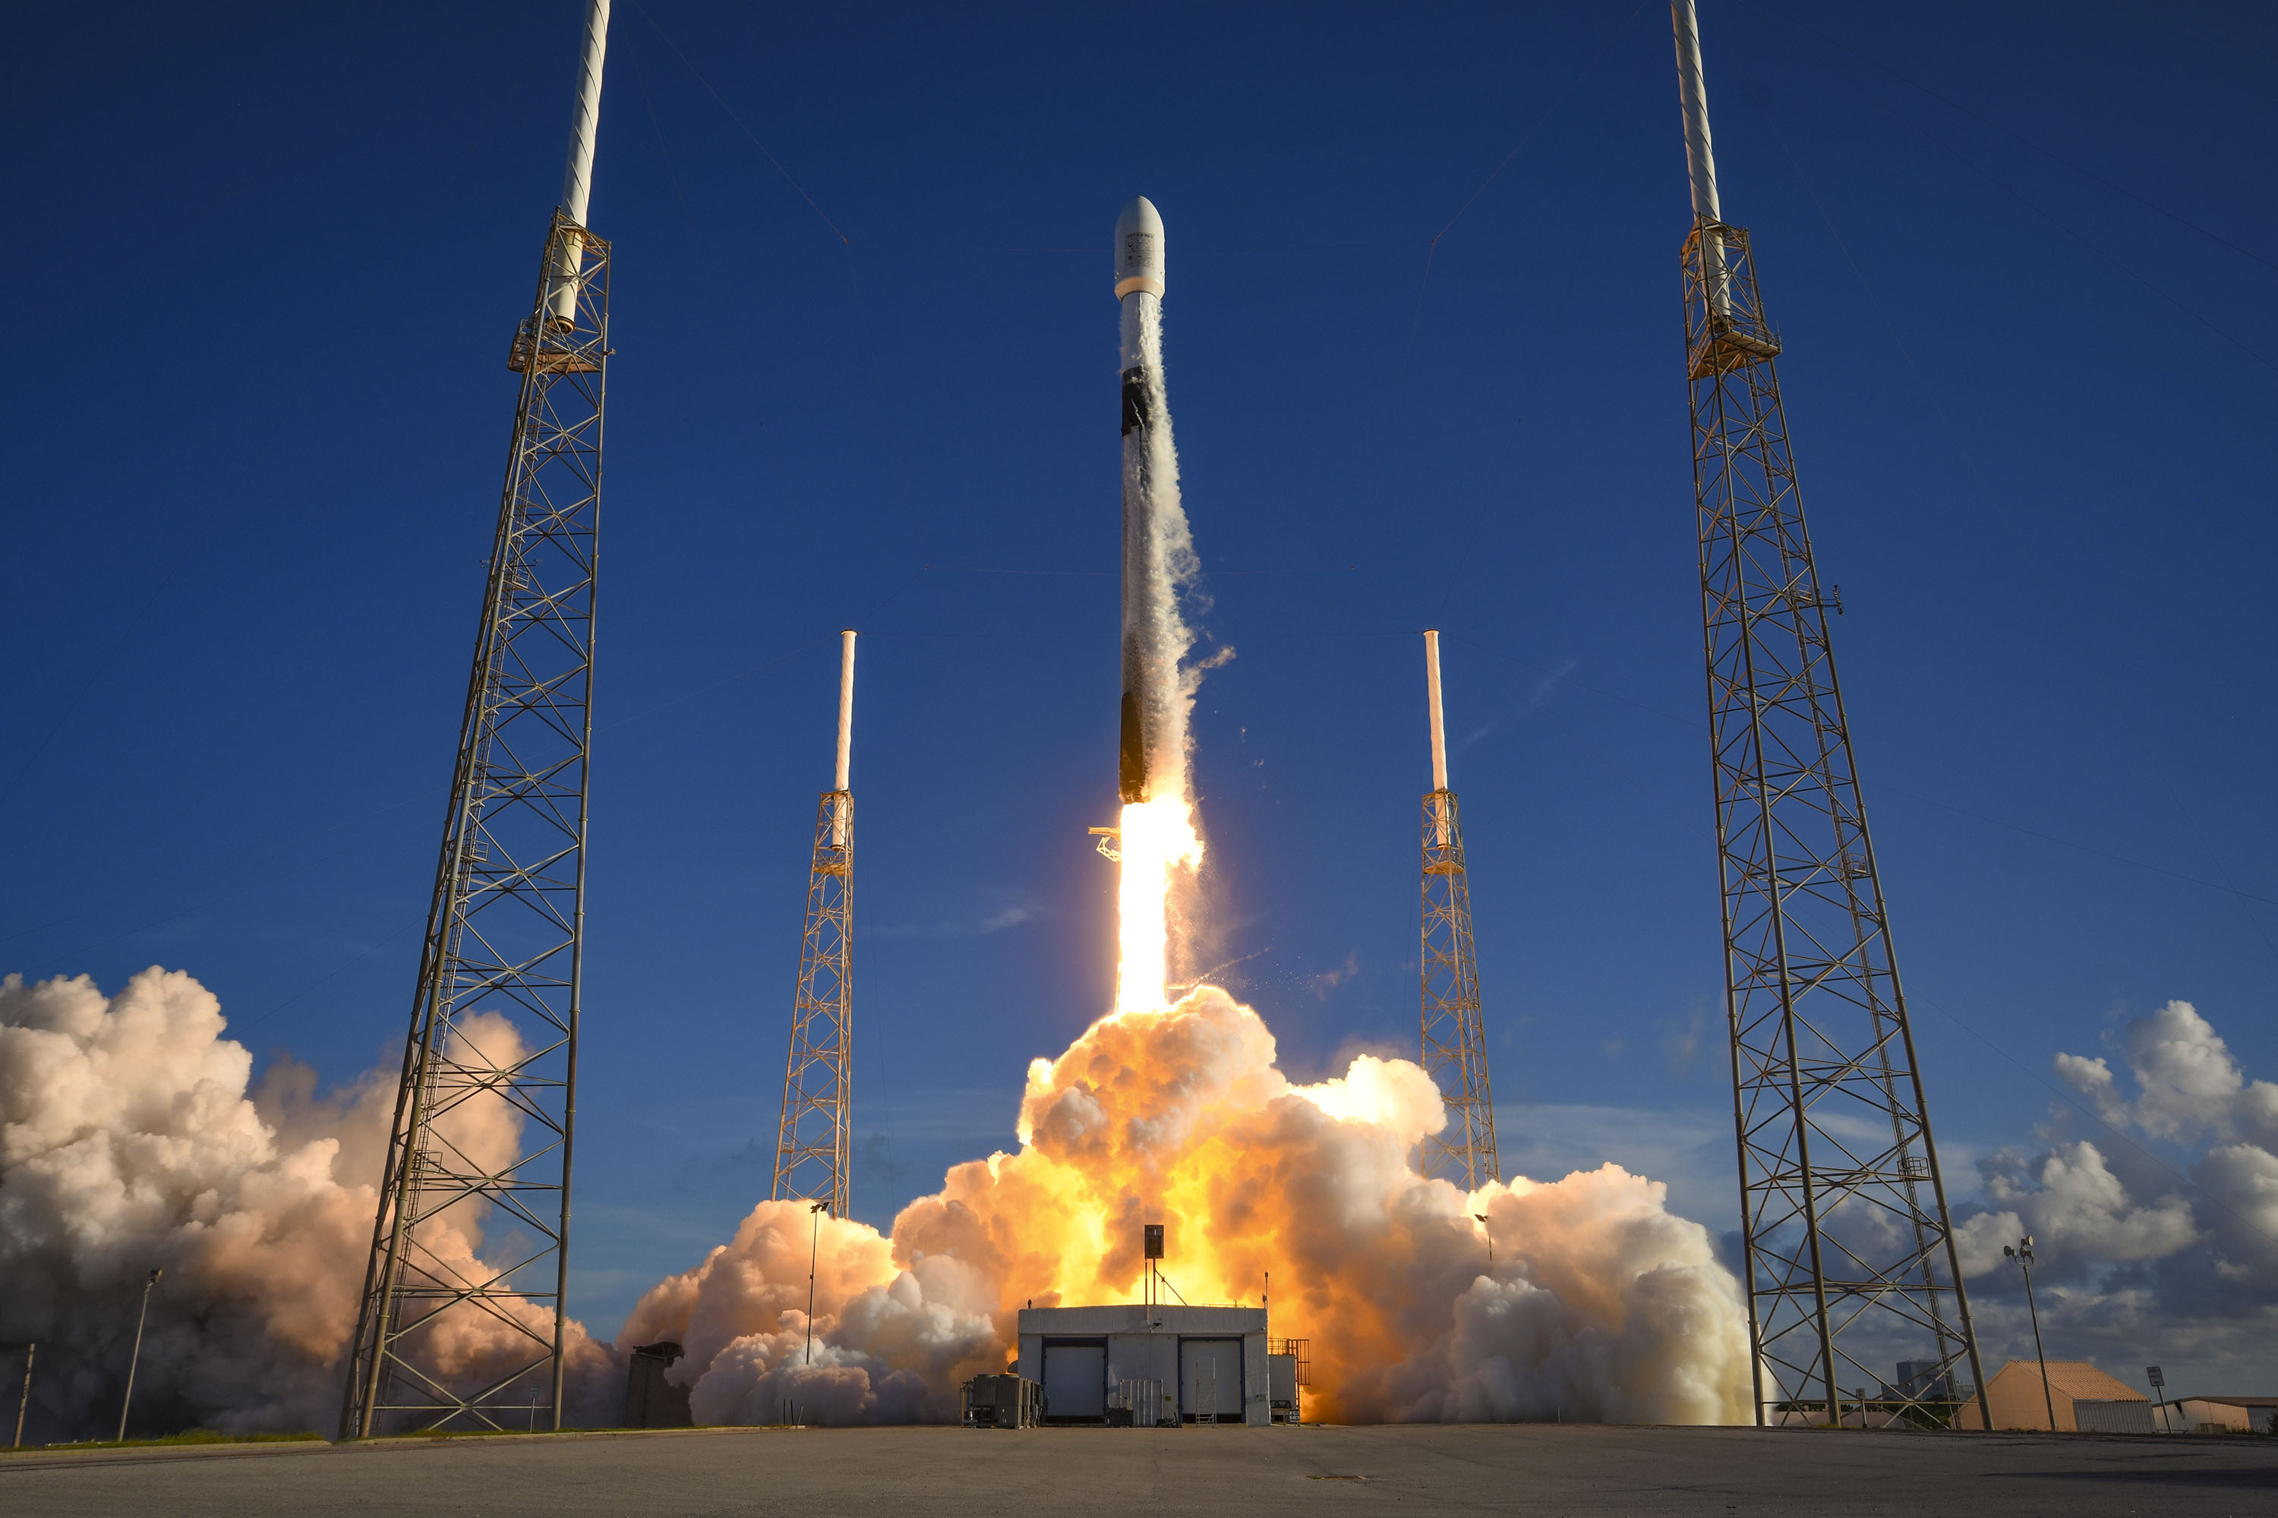
Thank You!

